Slide 1



Noida Institute of Engineering and Technology, Greater Noida
Customer Relationship Management (AOE0865)
Unit: 4
Unit 4: CRM Analytics
Ms. Rachna Sharma
CSE(DS) Department
B Tech 8th sem

Slide 2
Noida Institute of Engineering and Technology, Greater Noida
What is Analytical CRM?
Definition: Analytical CRM focuses on analyzing customer data to improve business strategies, enhance customer satisfaction, and boost sales.
Key Functions:
Identifying customer behavior and trends
Predicting customer needs
Enhancing decision-making with data insights
Goal: Optimize customer relationships and drive business growth.

Slide 3
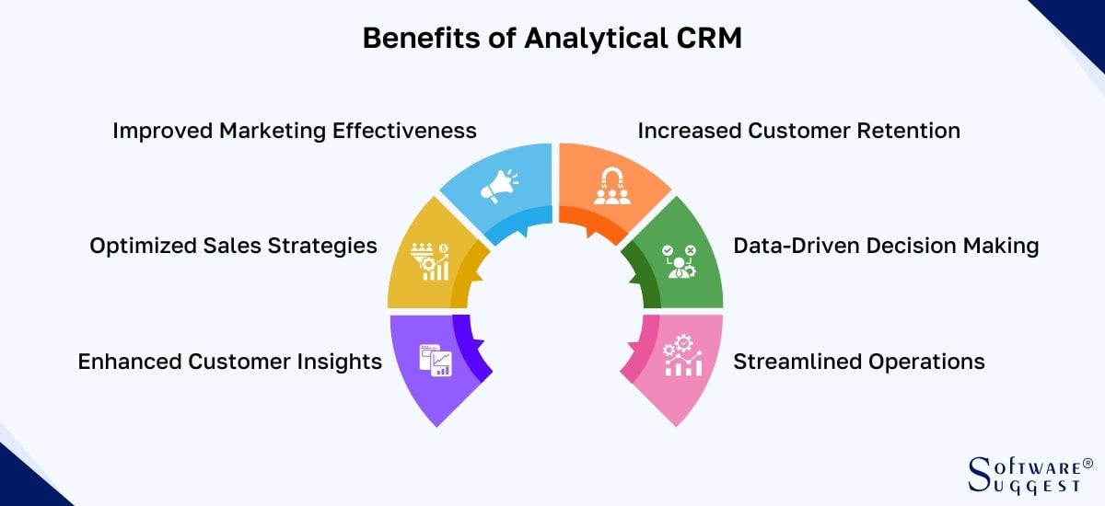
Noida Institute of Engineering and Technology, Greater Noida

Slide 4
Noida Institute of Engineering and Technology, Greater Noida
Analytics for CRM Strategy
Role of Analytics in CRM:
Data collection from various customer touchpoints
Segmentation and profiling of customers
Predictive analytics for anticipating customer behavior
Key Metrics:
Customer Lifetime Value (CLV)
Customer Retention Rate
Net Promoter Score (NPS)
Tools Used: Python, R, Power BI, Tableau

Slide 5
Noida Institute of Engineering and Technology, Greater Noida
Big Data in CRM
What is Big Data?
Large, complex datasets from multiple sources
Includes structured and unstructured data
Importance for CRM:
Improves personalization and customer experiences
Real-time insights into customer behavior
Enables predictive modeling for targeted marketing
Technologies Used: Hadoop, Spark, AWS, Azure

Slide 6
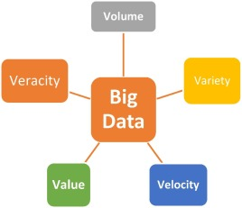
Noida Institute of Engineering and Technology, Greater Noida

Slide 7
Noida Institute of Engineering and Technology, Greater Noida
CRM Technology: Database Management
Definition: Storing and organizing customer data systematically
Features:
Data consistency and integrity
Centralized access for all stakeholders
Scalability and security
Examples: SQL, MongoDB, PostgreSQL

Slide 8
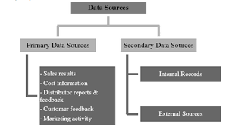
Noida Institute of Engineering and Technology, Greater Noida

Slide 9
Noida Institute of Engineering and Technology, Greater Noida
Data Warehousing in CRM
Definition: A centralized repository for storing large volumes of data from multiple sources
Role in CRM:
Facilitates advanced analytics
Provides a single source of truth for customer data
Supports data-driven decision-making
Examples: Snowflake, Amazon Redshift, Google BigQuery

Slide 10
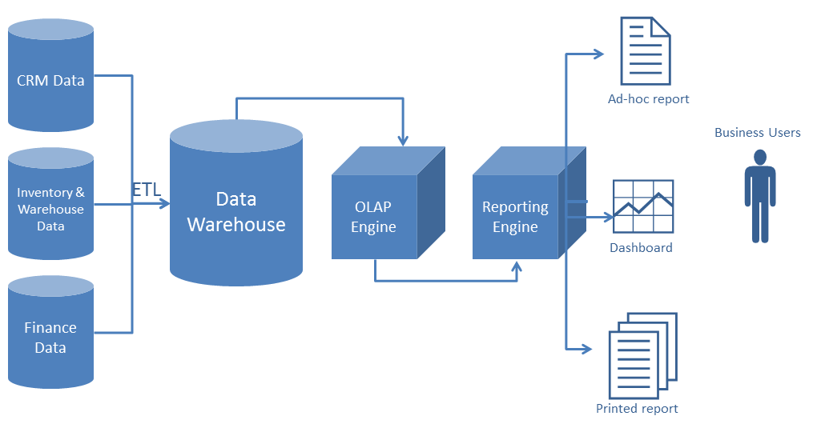
Noida Institute of Engineering and Technology, Greater Noida

Slide 11
Noida Institute of Engineering and Technology, Greater Noida
Data Mining in CRM
Definition: Extracting valuable insights from large datasets
Techniques:
Association rules
Classification and clustering
Regression analysis
Applications in CRM:
Identifying customer churn
Cross-selling and upselling
Personalizing marketing campaigns

Slide 12
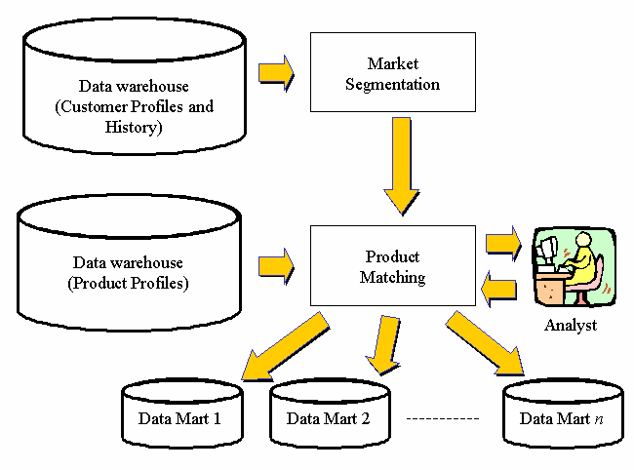
Noida Institute of Engineering and Technology, Greater Noida

Slide 13
Noida Institute of Engineering and Technology, Greater Noida
Customer Care Management Through IT Tools
Role of IT Tools in Customer Care:
Automating support processes
Enhancing customer communication
Streamlining issue resolution
Examples of Tools:
Chatbots and Virtual Assistants
CRM platforms like Salesforce, HubSpot, Zoho
Helpdesk software like Zendesk, Freshdesk

Slide 14
Noida Institute of Engineering and Technology, Greater Noida
Introduction to E-CRM
Definition:
E-CRM extends traditional CRM strategies by leveraging the internet and digital technologies.
Key Features:
Web-based customer interaction
Real-time analytics and reporting
Integration with social media and mobile platforms

Slide 15
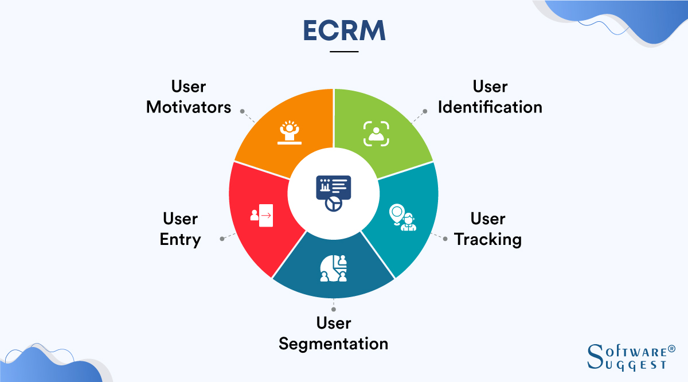
Noida Institute of Engineering and Technology, Greater Noida

Slide 16
Noida Institute of Engineering and Technology, Greater Noida
Advantages of E-CRM
Benefits for Businesses:
Improved customer engagement and satisfaction
Enhanced efficiency through automation
Cost-effective customer relationship management
Benefits for Customers:
Personalized and faster services
24/7 accessibility
Seamless multichannel experience

Slide 17
Noida Institute of Engineering and Technology, Greater Noida
Technologies Used in E-CRM
Key Technologies:
Cloud Computing
Artificial Intelligence and Machine Learning
Social Media Integration
Mobile CRM Apps
Popular Platforms: Salesforce, Oracle CRM, Microsoft Dynamics 365

Slide 18
Noida Institute of Engineering and Technology, Greater Noida
Applications of E-CRM
Industries Leveraging E-CRM:
Retail: Personalized offers and loyalty programs
Healthcare: Patient engagement platforms
Banking: Streamlined customer support
Travel: Real-time updates and customer interactions

Slide 19
Noida Institute of Engineering and Technology, Greater Noida
Case Study
Company: Amazon
Key CRM Strategies:
Advanced personalization through data analytics
Efficient customer service via chatbots and AI tools
Targeted marketing using predictive modeling
Results:
Increased customer retention
Enhanced customer satisfaction

Slide 20
Noida Institute of Engineering and Technology, Greater Noida
1.What is the primary goal of Customer Experience (CX) management in CRM? a) Reducing customer interactions b) Enhancing customer satisfaction and loyalty c) Increasing product costs d) Limiting marketing campaigns
2.Which factor is most important for a positive customer experience? a) High product price b) Consistent and personalized interactions c) Delayed responses to queries d) Reducing customer feedback
3.Social CRM integrates traditional CRM with: a) Social media platforms b) Manufacturing processes c) Supply chain management d) ERP software

Slide 21
Noida Institute of Engineering and Technology, Greater Noida
4.What is a major advantage of Social CRM? a) Reducing customer engagement b) Enabling real-time customer interactions on social media c) Eliminating the need for a CRM system d) Ignoring customer feedback
5.How does AI enhance CRM functionality? a) By automating customer interactions and personalizing services b) By replacing all human interactions with bots c) By increasing manual data entry tasks d) By limiting customer support availability
6.Which AI technology is commonly used in CRM for customer support? a) Blockchain b) Chatbots and Virtual Assistants c) CAD Software d) ERP Systems

Slide 22
Noida Institute of Engineering and Technology, Greater Noida
7.What is a key benefit of Cloud CRM? a) Requires high maintenance costs b) Provides remote access to CRM data c) Works only in offline mode d) Increases dependency on local servers
8.How does Big Data benefit CRM? a) It helps analyze large volumes of customer data for better decision-making b) It eliminates customer personalization c) It slows down CRM operations d) It reduces the amount of stored customer information
9.What does XaaS stand for in CRM technology? a) Xtreme Application Software b) Anything as a Service c) XML as a Service d) Exclusive Application Software

Slide 23


Thank You

